Slide 1

COVARIANCE AND CORRELATION

Slide 2



Covariance and correlation
Covariance is a quantitative measurement of the directional relationship between two variables
Positive covariance means that when one variable increases, the other also increases
Negative covariance means that when one variable increases, the other decreases.
Covariance

Slide 3

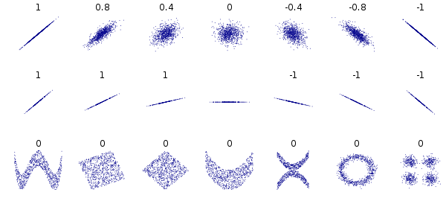
Correlation is a quantitative measurement of how strong is the linear relationship between two numerical variables
Covariance and correlation
Correlation (Pearson)
Correlation values are in the range [-1,1]

Slide 4
Other non-linear correlations
While linear relationships mean two variables move together at a constant rate,, monotonic relationships measure how likely it is for two variables to move in the same direction, but not necessarily at a constant rate (can be quadratic or other relationship).
We can quantify these other types of relationships with Kendall’s and Spearman correlations.

Slide 5

Kendall’s correlation
Kendall’s correlation is a quantitative measurement ranking agreement between two rankers.
It’s on the range. Range = [-1,1]
C = number of rankings higher than a given one.
D = number of rankings lower than a given one.
Correlation (Kendall)

Slide 6
Kendall’s correlation
Example
Factor | Ranker1 | Ranker 2 | C | D
Country | 1 | 5 | 2 | 4
GDP | 2 | 4 | 2 | 3
CO2 level | 3 | 2 | 3 | 1
Ed Level | 4 | 7 | 0 | 3
Tax level | 5 | 1 | 2 | 0
Green m2 | 6 | 3 | 1 | 0
Social ser. | 7 | 6
C= Number of numbers higher than 5
D= Number of numbers lower than 5
Tau = ((2-4)+(2-3)+(3-1)+(0-3)+(2-0)+(1-0)/(2+4)+(2+3)+(3+1)+(0+3)+(2+0)+(1+0))
=((-2)+(-1)+(1)+(-3)+(2)+(1))/((6)+(5)+(4)+(3)+(2)+(1))

Slide 7

Spearman correlation is a quantitative measurement how different are the rankings of two rankers Range = [-1,1]
To compute it take the following steps:
Sort the values of both variables from the lowest to the highest.
For each variable, replace every value by the rank (order, 1 for the highest value, 2 for the second highest, and so on) of the value
Compute the difference in rankings for each pair of values for both variables
Square the previous differences: D2
Use the formula
Covariance and correlation
Correlation (Spearman)

Slide 8
Spearman’s correlation
Example
Factor | Ranker1 | Ranker 2 | D | D2
Country | 1 | 5 | -4 | 16
GDP | 2 | 4 | -2 | 4
CO2 level | 3 | 2 | 1 | 1
Ed Level | 4 | 7 | -3 | 9
Tax level | 5 | 1 | 4 | 16
Green m2 | 6 | 3 | 3 | 9
Social ser. | 7 | 6 | 1 | 1
rho = 1 - 6*(16+4+1+9+16+9+1)/(7*(7^2-1)) =
1 - (6*56)/(7*48) =
1 - (336/336) = 0
rho = 0

Slide 9
Kendall’s vs Spearman’s
Kendall’s correlation:
computes one to many ranking comparisons.
proportion of concordant pairs vs total pairs
Spearman’s correlation:
computes one to one ranking comparisons.
very sensitive to big differences in ranking.

Slide 10
Covariance and correlation
Use the Panda’s method: .corr(method=) where the keyword “method” can be:
‘pearson’
‘spearman’
‘kendall’
Computing all those things

Slide 11
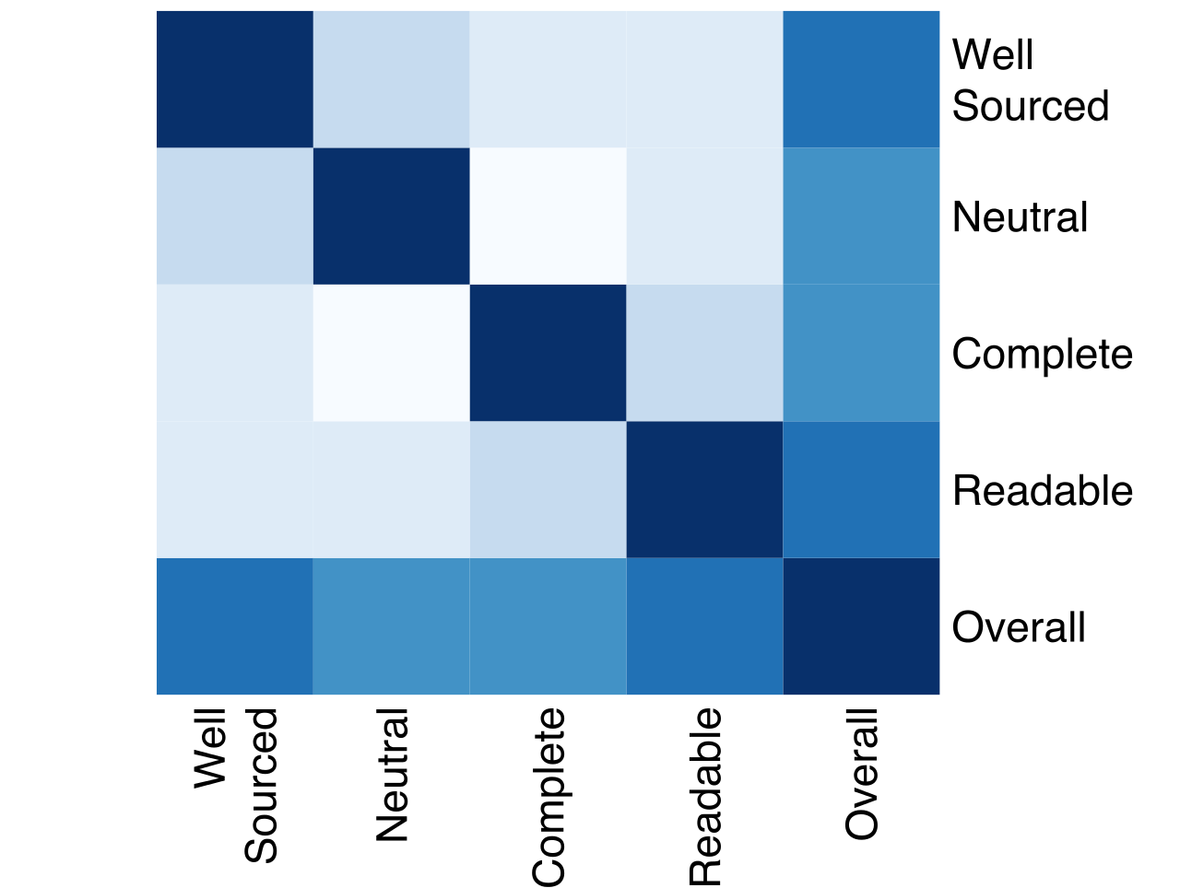
Covariance and correlation
A heatmap is a plot which display a matrix of floats with a color scale.
To plot a heatmap use the following approach:
corr_matrix = df.corr()
fig, ax = plt.subplots(figsize=(10, 8))
sns.heatmap(corr_matrix, annot=False, ax = ax)
plt.show()
https://seaborn.pydata.org/generated/seaborn.heatmap.html
Heatmap

